Slide 1
Development of mobile applications using PhoneGap and HTML 5
Faculty of Electrical Engineering University of Banja Luka
Igor Dujlović
2014

Slide 2
Content
Types of mobile applications
Elements of hybrid mobile applications
Mobile applications structure
Advantages and disadvantages of PhoneGap and HTML5 applications
Technologies used for development of hybrid mobile applications

Slide 3
Types of mobile applications
Three basic types of mobile applications are:
Native
Web
Hybrid
Criteria for defining types:
Technology used for development
Usage of the same application on different mobile platforms (cross-platform)
Supported features

Slide 4
Native mobile applications
Developed for a specific mobile platform
Use original SDK, programming language for specific platform, use all supported features
High performance

Slide 5
Web applications
Developed using web technologies
Web application customized for mobile browsers (design, resolution, layout)
Lack of support for all mobile phone features
Same application can be used on many different mobile platforms

Slide 6
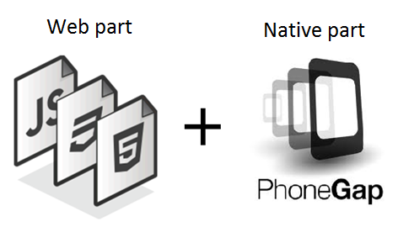
Hybrid applications
Combination of native and web mobile applications
Can be used on different mobile platforms
Developed using web technology and native parts

Slide 7
Types of mobile applications
Full capability
Native
Hybrid
Web
Advanced UI interactions
Fastest performance
App store distribution
Web developer skills
Access to native platform
App store distribution
Single platform
Multiple platforms
Web developer skills
Instant updates
Unrestricted distribution
Partial capability

Slide 8
Web part of hybrid mobile application
Used for development of user interface and business logic
HTML5, JavaScript, CSS3, other libraries

Slide 9
HTML 5 & CSS 3
HTML 5 offers a lot of new features that can be used for development of mobile applications
CSS3 provides animations, transitions, visual effects, …
Useful HTML5 features:
Geolocation API, storage, local database (available in PhoneGap), audio, video, graphics, form elements, WebSockets…
Some features are not supported on all mobile platforms

Slide 10
JavaScript & other libraries
JavaScript is used for development of business logic, dynamic page layout change, data processing…
In complex applications maintaining of the JavaScript source code is difficult
JavaScript frameworks provide better source code structure and more features:
AngularJS, BackBone.js, jQuery Mobile…

Slide 11
Native part of hybrid mobile application
Provides access to the Smartphone features from the web part
Provides format that can be used for specific mobile platforms
Native part is developed in a programming language and IDE specifically designed for one mobile platform
Must be accessible from the web part (often with JavaScript interface)

Slide 12
PhoneGap
PhoneGap is a free and open source framework that allows development of mobile apps using standardized web APIs for the many supported platforms
Contains native libraries and allows compiling applications in a native environment for a specific platform
PhoneGap supports many features that are accessible with JavaScript API and supports development of custom plug-ins

Slide 13
PhoneGap
Mobile application
Mobile operating system
Web part
API
Features and services
API calls
API calls
PhoneGap
API calls

Slide 14
Mobile application structure
GUI Layer
Data Layer
Network layer
Application main controller
Controllers

Slide 15
Mobile application structure
GUI layer
SPA – Single Page Application
HTML 5 pages without any programming logic
It is good to use existing frameworks such as jQuery Mobile that contain components, effects…
Controllers
One controller for one HTML page
Provides event handles, calls to other application layers, calls to native features, HTML page layout manipulation, data processing…
Simplification of source code maintenance in complex applications
Provides better application controls, navigation rules…

Slide 16
Mobile application structure
Data Layer
Allows using local SQLite database or web storage objects
Often used for offline application mode
Network layer
Provide access to web services
Application main controller
Controls global events, application state, navigation, monitor network state…

Slide 17
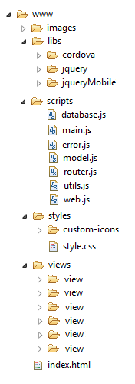
Mobile application structure
This organization enables easier maintenance, development and extending application features because it provides modular organization
Source code can be organized as it is shown on image

Slide 18
Advantages
Same source code can be used for different platforms
Fast development
Usage of simple technologies
Low costs

Slide 19
Disadvantages
Lower performance than in native applications
Every plug-in must be developed for every platform
Limitations in usage of GUI elements for specific platforms if it can not be developed with HTML5 and CSS3

Slide 20
Conclusion
PhoneGap is good for development of applications which don’t require high performance (3D games, intensive processing, multimedia processing…)
Useful for development of business applications or mobile clients of information systems

Slide 21
Thank you for your attention!

